Slide 1
Exploratory Data Analysis- Retail Sample Super Store Beginner Level By- Bishal Kumar Das
Task – 3
The spark foundation

Slide 2
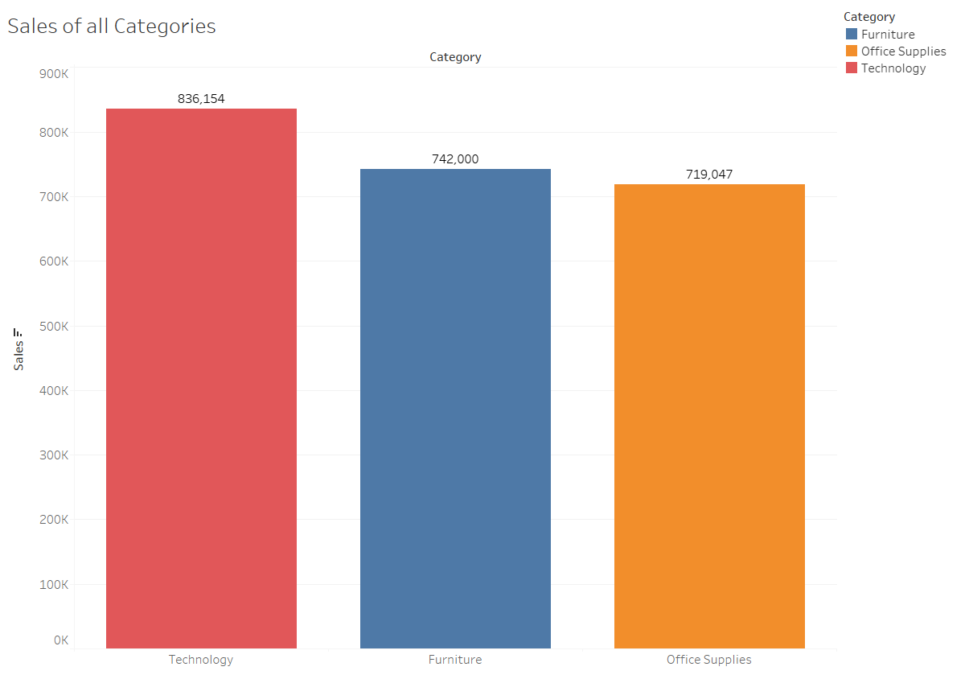
Total sales of all categories

Slide 3
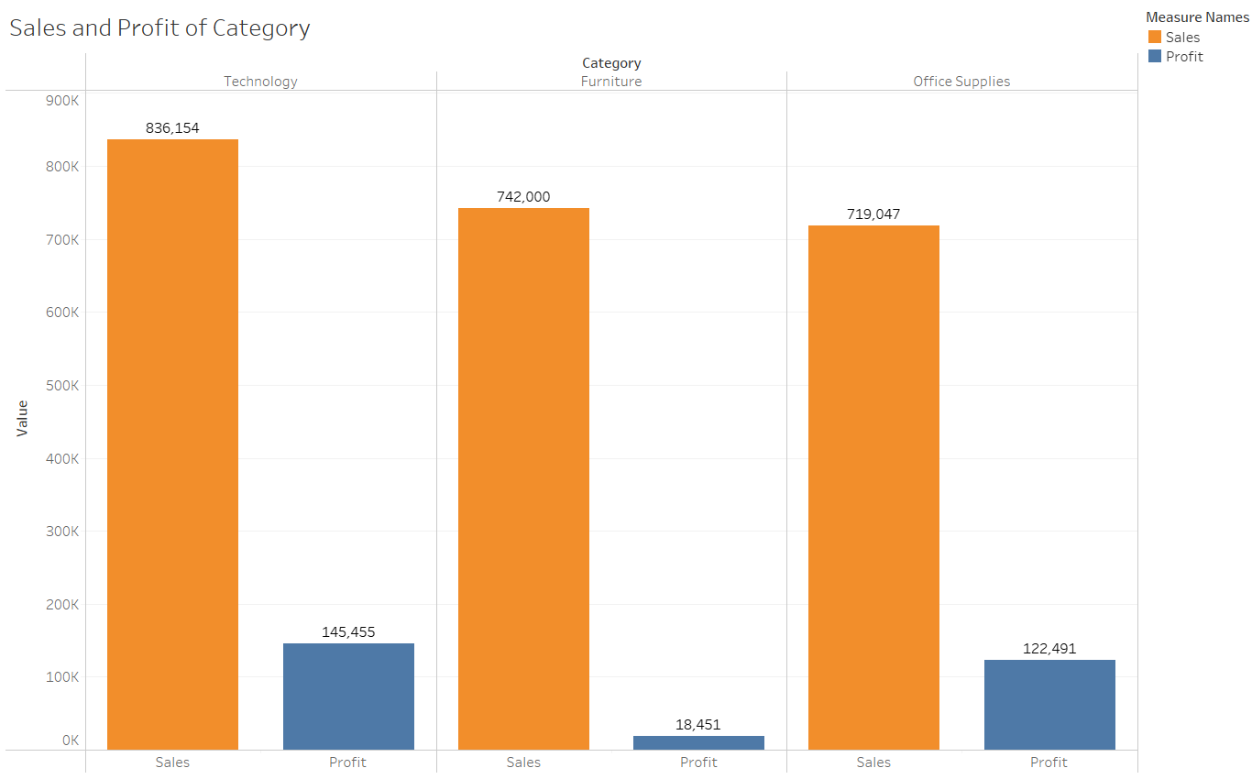
Total number of sales with profit of all categories

Slide 4
So as shown in last slides
Technology has made the maximum sales in the market with $836,154 and profit of $145,455
Then Furniture has made the sales of $742,000 and profit of $18,451
At last Office supplies has made sales of $719,047 and profit of $122,491
As per the data, super store should start working on sales of Furniture and Office supplies.
Specially if we talk about the sales of Furniture even after sales of furniture is more than office supplies its profit is much less than office supplies.
So in this case either stores have to increase the sales of the category or should work on the profits by increasing price of the product or any other profit maximizing technique.

Slide 5
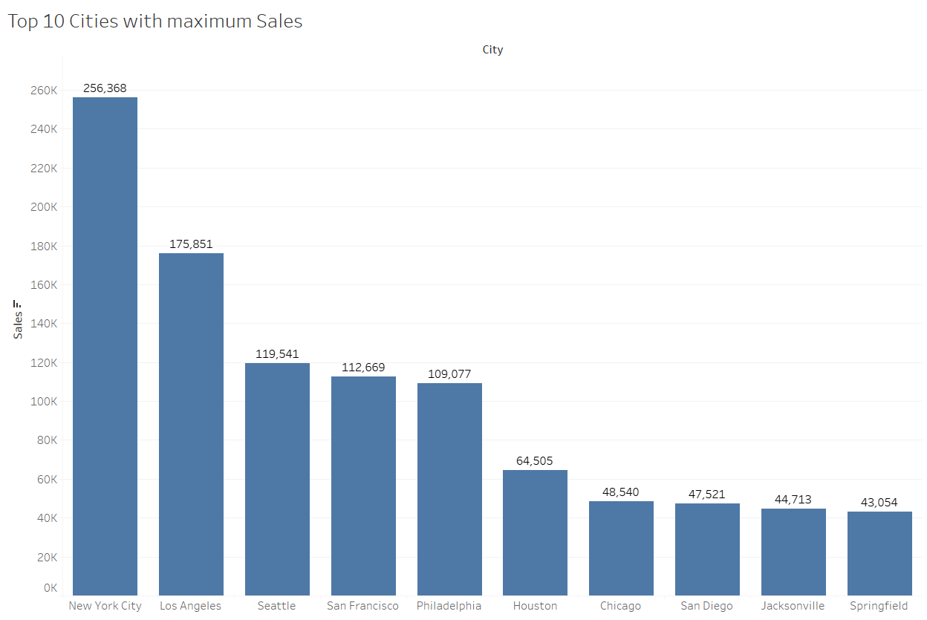
Top 10 cities with maximum sales

Slide 6
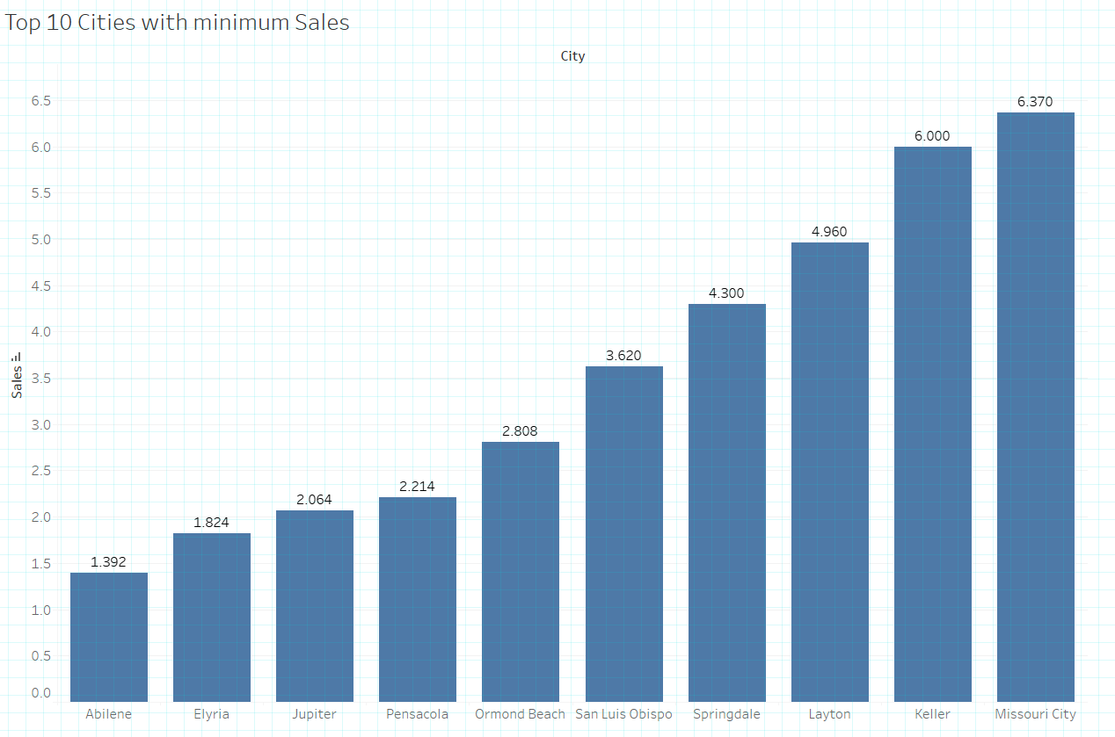
Top 10 Cities with minimum sales

Slide 7
As show in previous 2 slide top 10 cities with highest sales are
New York City with sales of $256,368
Los Angeles with sales of $175,851
Seattle with sales of $119,541
San Francisco with sales of $112,669
Philadelphia with sales of $109,077
Houston with sales of $64,505
Chicago with sales of $48,540
San Diego with sales of $47,521
Jacksonville with sales of $44,713
Springfield with sales of $43,054
Top 10 cities with lowest sales are
Abilence with the sales of $1,392
Elyria with the sales of $1,824
Jupiter with the sales of $2,064
Pensacola with the sales of $2,214
Ormond Beach with the sales of $2,808
San Luis Obispo with the sales of $3,620
Springdale with the sales of $4,300
Layton with the sales of $4,960
Keller with the sales of $6,000
Missouri City with the sales of $6,370

Slide 8
Super store in cities like Abilence, Elyria, Jupiter, Pensacola, Ormond Beach, San Luis Obispo, Springdale , Layton, Keller, Missouri where we can see the sales are less, stores should work on sales in these cities by Marketing and taking feedback from the customers.

Slide 9
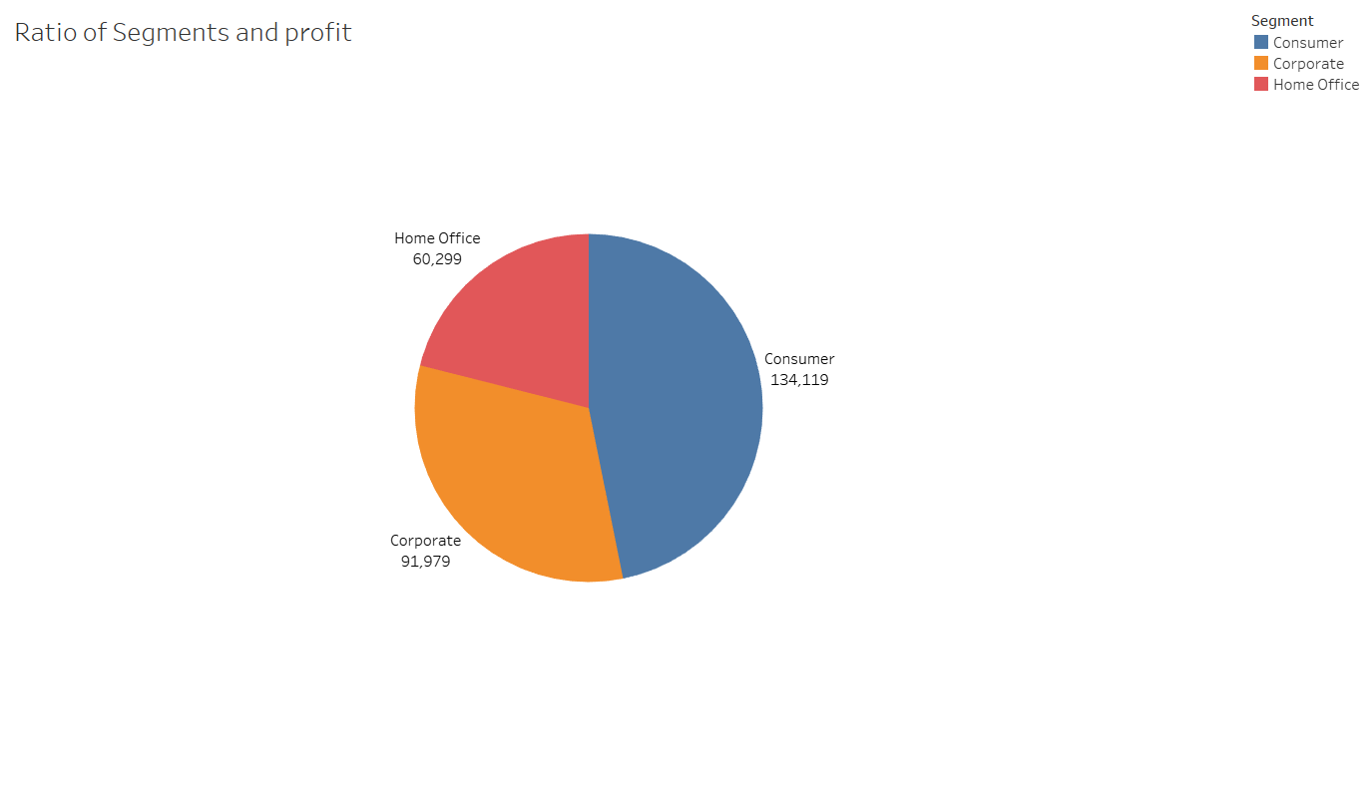
Ratio of Segment and Profit
As per this pie chart the highest profit coming from Consumer segment.

Slide 10
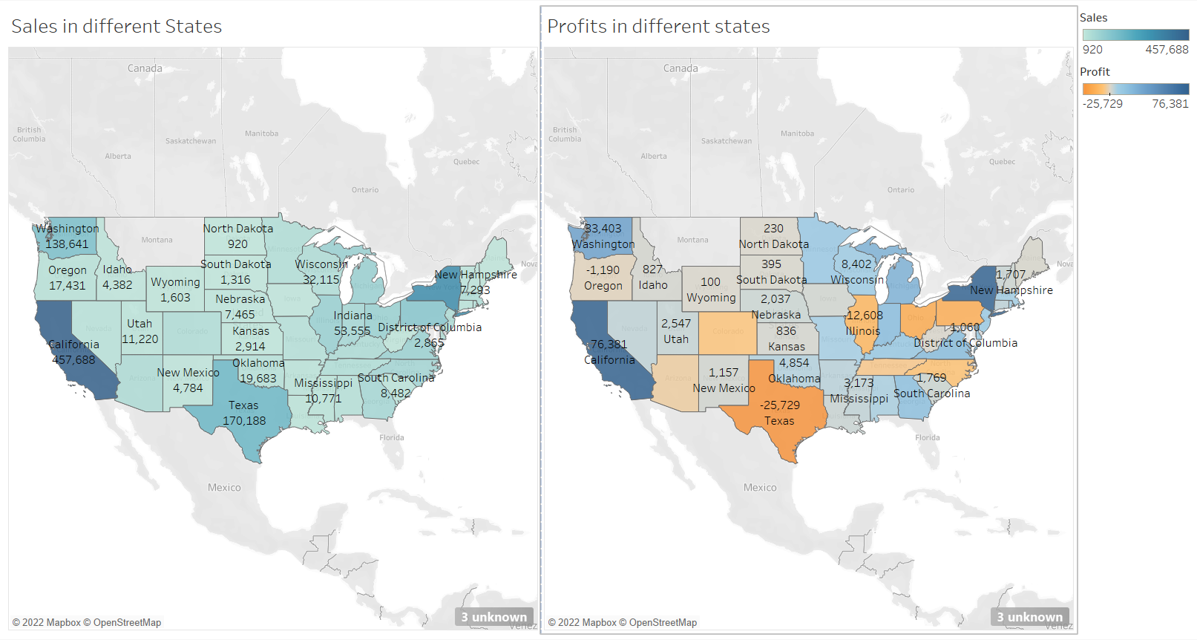
State wise representation of sales and profit

Slide 11
As per the previous slide the top state with high sales is California and top state with high profit is also California but in case of Texas the sales are high but the profit is in the negative i.e.-($-25,729).
This also proves that high sales does not mean high profit.
So stores should not only focused on sales but also on the profit.

Slide 12
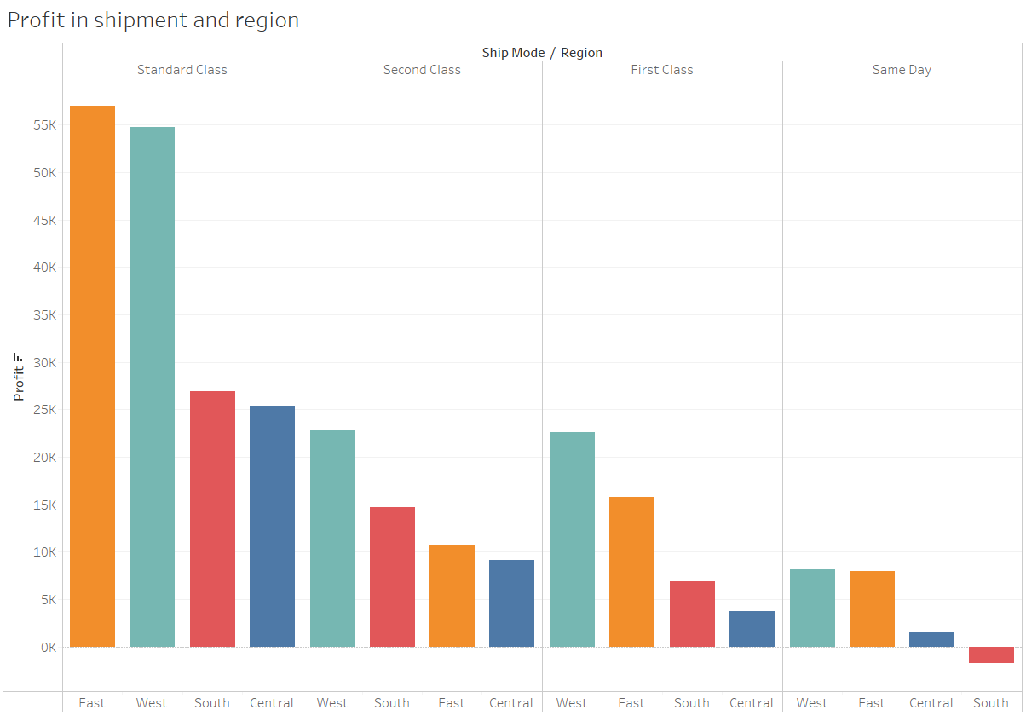
Profit in shipment and region
As we can see here in Standard Class we can see most profit and in Same day ship mode there is less profit.
Specially in South region of Same day shipment mode store is facing loss.

Slide 13
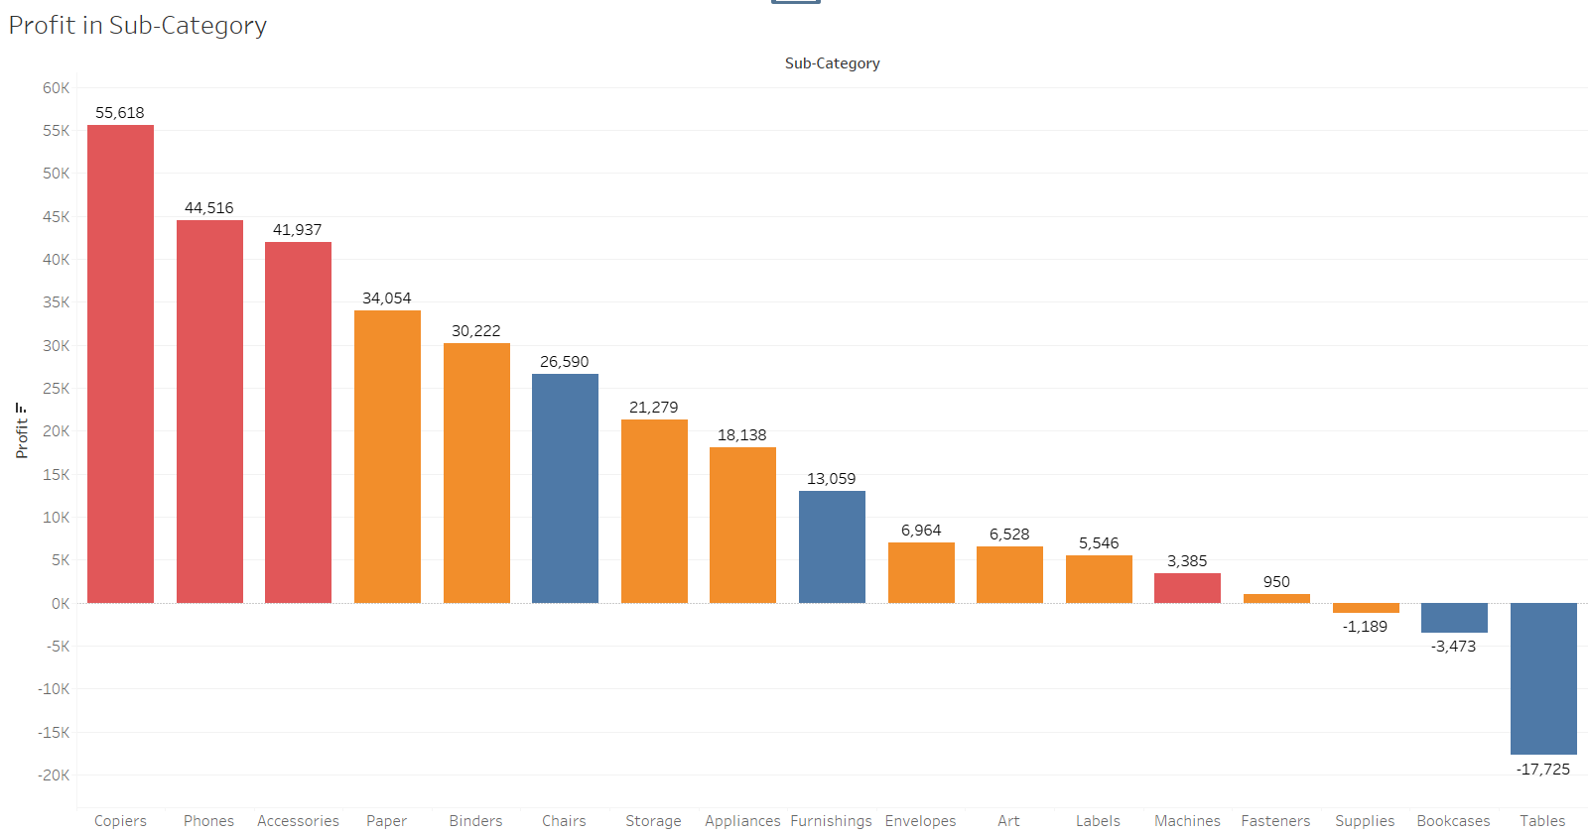
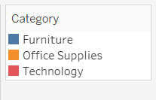
Profit from Sub-Category

Slide 14
As we can see the Sub-Category of Technology is performing good in profit where as Office Supplies are facing loss in Sub-Category Supplies and Furniture is facing loss in Sub-Category Bookcase and Tables.
So here we know why over all sales of Technology is higher than Office Supplies and Furniture because Subcategory of Technology is performing good as I said before, where as some subcategory of Office Supplies and Furniture is facing loss.
Stores have to work on Sub-Category Supplies, Bookcase and Table.

Slide 15
At last we have conclude that Super Store should
Either stores have to increase the sales of the category or should work on the profits by increasing price of the product or any other profit maximizing technique.
Super store in cities where we can see the sales are less, stores should work on sales in these cities by Marketing and taking feedback from the customers.
As per the slide 10 top state with high sales is California and top state with high profit is also California but in case of Texas the sales are high but the profit is in the negative which proves that high sales does not mean high profit.
Stores should not only focused on sales but also on the profit.
As per the slide 12 in South region of Same day shipment mode store is facing loss. So they have to work on it perhaps they can remove this same day shipment mode in south region or should increase shipment charges.
Stores have to work on Sub-Category Supplies, Bookcase and Table where they are facing loss.
That is all I found by doing analysis in Super Store data

Slide 16

Thank you

